Slide 1
FILE HANDLING
Prepared by Geetanjali Hota
PGT. Computer Science , DAV

Slide 2

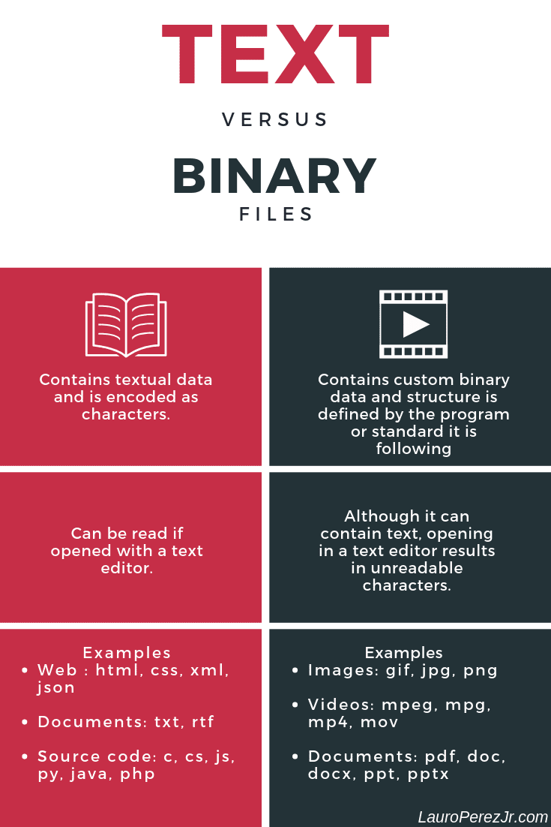

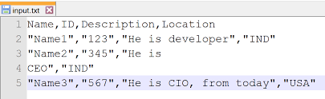
There are THREE types of files in Python They are:
TEXT
BINARY
CSV

Slide 3

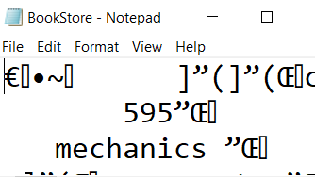
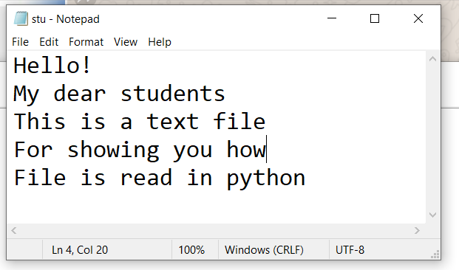
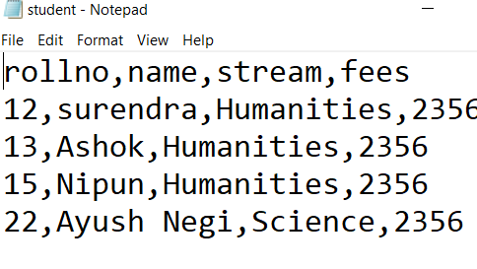
TEXT FILES
Sequential characters.
Line terminates with
the newline character (\n).
Human Readable
Slower Execution
Takes more space
Easily Portable
Example: Documents: txt,RTF,Vi,nano,TTextEdit etc.
BINARY FILES
Stores data using their memory representation.
Unreadable
Faster Execution
Less Space
Not easily portable
Example:
Image files: .png, .jpg,.gif
Video files: .mp4, .3gp,
Audio files: .mp3, .wav .
CSV FILES
Stands for Comma
Separated Values.
Easily Readable
Handle large data
Data is stored in
tabular form .
Can be export and
import easily
Example -Tabular data: csv, tsv

Slide 4
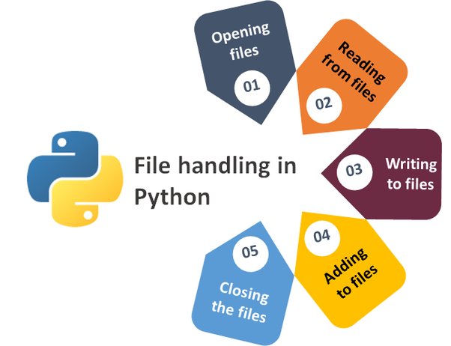
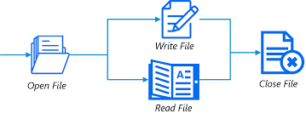
Naming File
Opening File
Writing File
Reading File
Closing
File
Basic
operations
on data
File

Slide 5
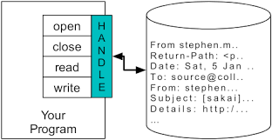
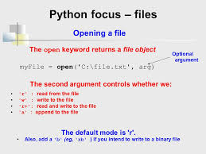
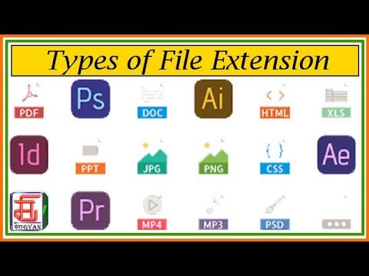
Opening a File
Opening a File
File_object = open(r"File_Name", "Access_Mode")
File handler is like a cursor, which defines from
where the data has to be read or written in the
file byte by byte or line by line .
.
File_object = open(r"File_Name", "Access_Mode")
File handler is like a cursor, which defines from where the data has to be read or written in the file
Access modes govern the type of operations possible in the opened file
The file should exist in the same directory as the Python script, otherwise full address of the file should be written.
Access modes govern the type of operations possible in the opened file

Slide 6

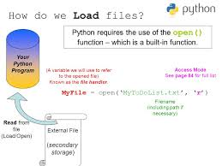
Opening a File
1
Myfile=open(‘PKT.txt’)
File Object
2
Myfile=open(‘PKT.txt’,’r’)
3
Myfile=open(‘c:\\temp\\data.txt’,'r')
ABSOLUTE
PATH
4
RELATIVE
PATH
Myfile=open(r’..\data.txt’, ‘r')

Slide 7

Closing a File
Myfile.close()
File Object
After the write method, whatever data we have written to a file will be saved into the file.

Slide 8
Example: The with statement
# Creating a file
with open(r"C:\Users\myfile2.txt", "w") as file1:
# Writing data to a file file1.write("Hi!!!!! \n")
# to change file access modes
with open(r" C:\Users\myfile2.txt", "r+") as file1:
# Reading from a file
print(file1.read())
Tip
Statements inside the with statement must be indented equally just like the
for loop
otherwise Syntax Error exception will be raised.
ALLOWS THE FILE TO GET AUTOMATICALLY CLOSED ONCE WORK IS DONE

Slide 9
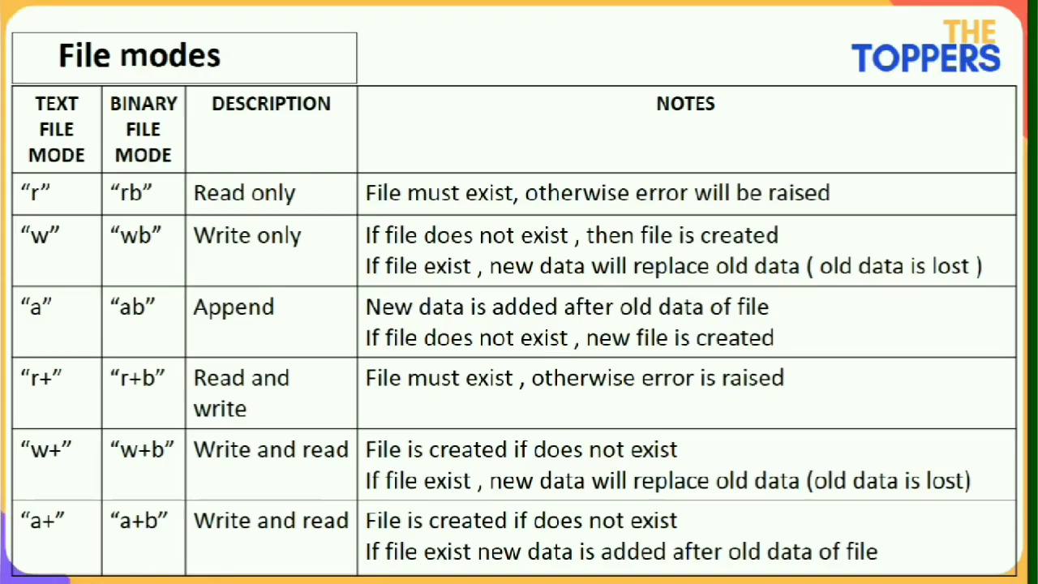
ACCESS MODES
.
Tip
Example 1:
fo = open(“C:\\Python\\test.txt”, “r+”)
Example 2:
fo = open(“C:\\Python\\img.bmp”, “rb+”)
POLLING

Slide 10
str=myfile.read(30)
#1. Next read() reads the next 30 characters from the last read
F=open(r”E:\poem.txt”, “r”).read(30)
#2. Entire file will be read
F=open(“poem.txt”,“r”).read()
#3. Reads one line from the file
F=open(“poem.txt”, “r”).readline()
#4. Reads 5 characters from the current line
F=open(“poem.txt”, “r”).readline(5)
#5. reads all lines and returns each line as a string elements in a list
F=open(“poem.txt”, “r”).readlines()

Slide 11

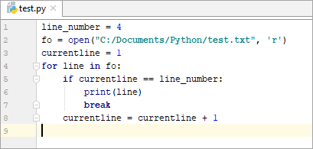
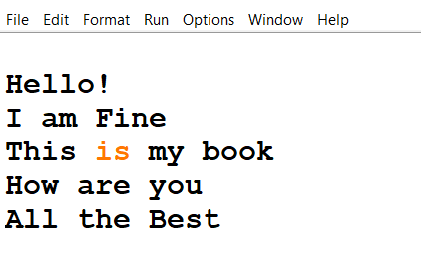
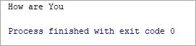
Read only the 4th line from the ‘test.txt’ file
FILE contains “GOOD” before execution
F=open(“main.txt”,”w”)
F.write(“Bye”)
F.close()
FIND THE ERROR
OP:
Bye
Write the last line of a text file “data.txt”
F=open(“data.txt”,” r ”)
Line = F.readlines( )
print(“last line= ’,Line[-1])

Slide 12

Random Access File Pointer
tell()
seek()
It returns the current position of the file handler.
Syntax: fileObject.tell()
File pointer moves record by record. Number of bytes may not be same for each record as values can be different
Moves the file handler to the desired location.
Syntax: fileObject.seek(offset, whence)
offset: position of the read/write pointer within the file
whence: optional and defaults to 0

Slide 13
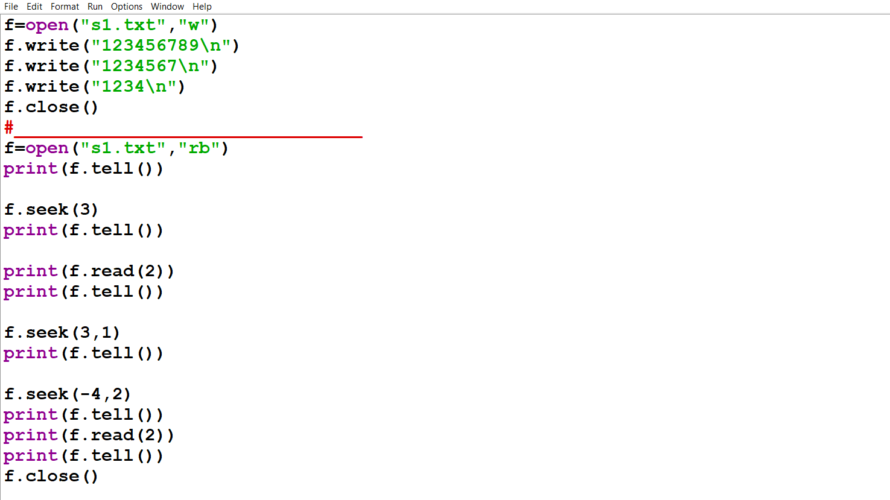

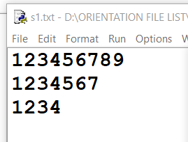

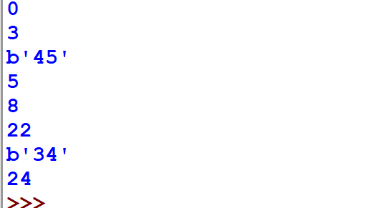
1. F=open(‘SS’ , ‘r+’)
2. F.write (‘0123344’)
3.F.write(‘XYZERT’)
4. F.close()
5. F.seek(0)
6. F.read()
FIND THE
ERROR

Slide 14
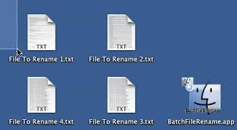

Syntax: os.rename(current_file_name, new_file_name) Example 1: import os os.rename(“test.txt”, “test1.txt”) Here ‘test.txt’ -> Current file name ‘test1.txt’ -> New file name. ALTERNATIVE METHOD : import os os.rename(“C:\\Documents\\Python\\test.txt”, “C:\\Documents\\Python\\test1.txt”)
rename() method:.

Slide 15
remove() method:
remove() method:
.
Deletes the file by supplying the file name or the file location that
you want to delete.
Syntax: os.remove(file_name)
#Check if file exists, then delete it:
import os
if os.path.exists("demofile.txt"):
os.remove("demofile.txt")
else:
print("The file does not exist")

Slide 16


flush()
It forces the writing of the data on the disc which still
Pending in output buffer before the program gets closed .
f=open(r"C:\Geetanjali\out.dat","w+")
f.write("The output is \n")
f.write(‘My’+‘work status’+ ‘is’)
f.flush()
f.write("Finally Over \n")
f.close()

Slide 17
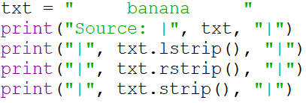
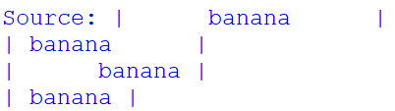
strip() Examples
Leading spaces
Trailing spaces

Slide 18

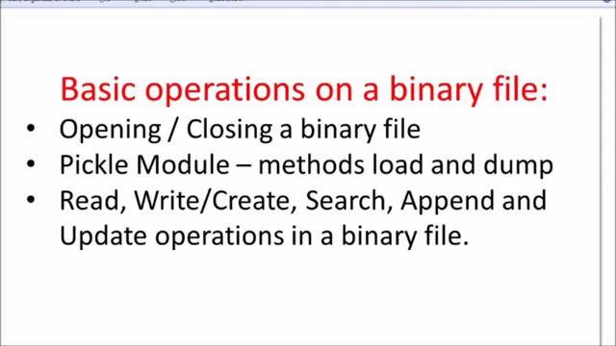
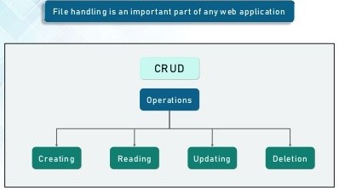
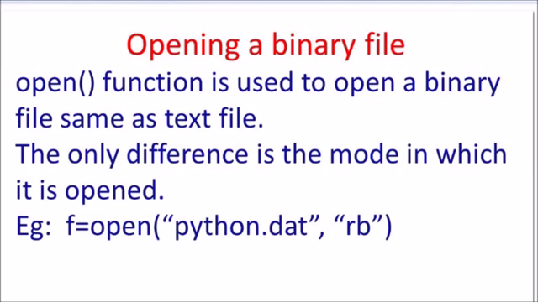
Binary file handling

Slide 19
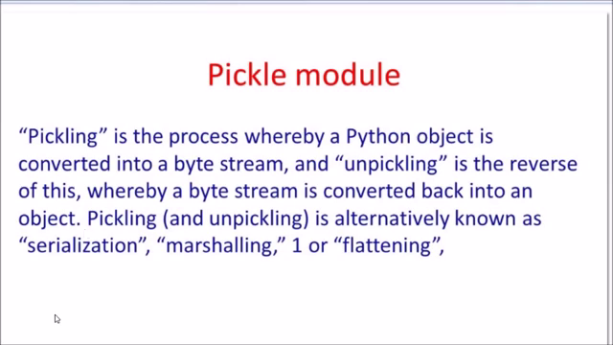
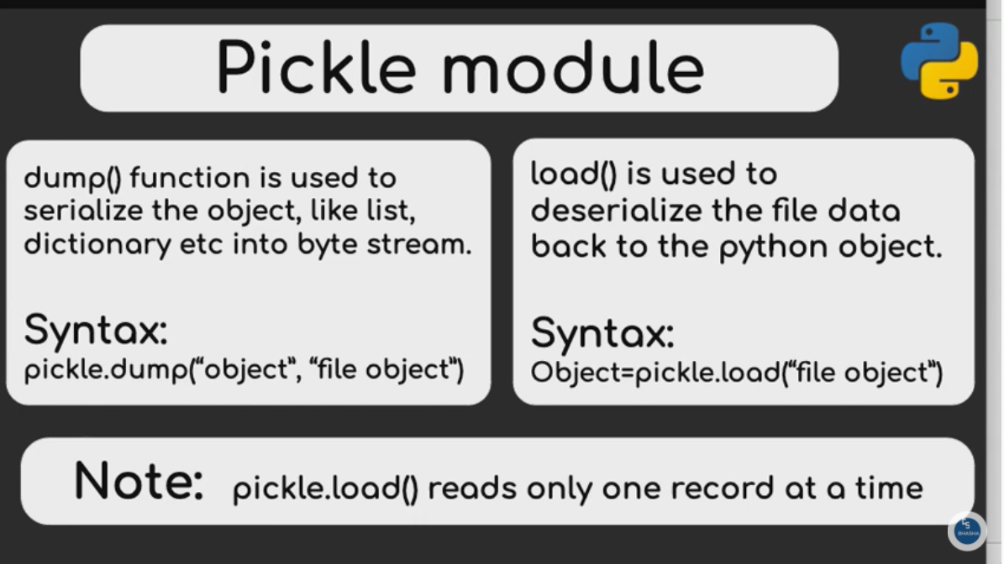

Slide 20

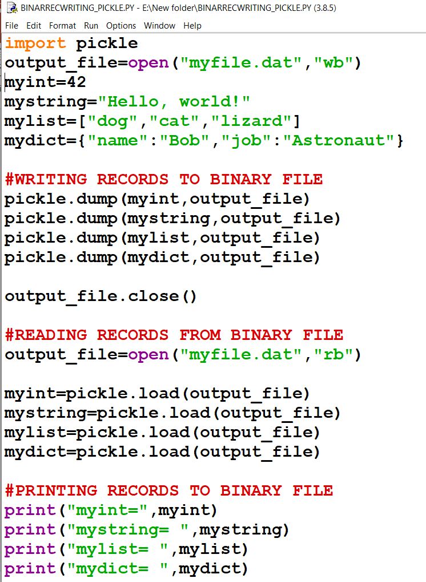
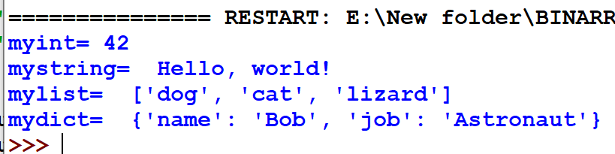
Writing and Reading in Binary File
1. import pickle
2. Data = [‘ one , 2, [3,4,5] ]
3. with open (data.dat’,rb’) as F :
4. pickle. dump(data ,F)
FIND ERROR

Slide 21

Write a function which will MODIFY the percentage of mark of a student according to the roll number provided by the user.
UPDATING RECORD WITH SPECIFIC CONDITION

Slide 22

Updating in Binary File
Updating in Binary File When data was entered as multiple records
def UPDATE ( ) :
F=open(“ss.dat”, ”rb+”)
rnm=int(input(“Roll to be updated ”))
Pos=0
Found=0
try:
while True:
Pos=F.tell()
R=pickle.load(F)
if R[0]==rnm:
R[2]=float(input(“Enter new percentage ”))
F.seek(Pos)
pickle.dump ( R , F )
Found+=1
except EOFError:
print(“Record not found”)
F.close()
Binary file is opened in rb+ mode
Pos is holding the current cursor position of the file record
Data is loaded record by record in the
object R
If the required rollno is found ,then the pointer is taken to the beginning of the previous record
If record not found then close the file .

Slide 23
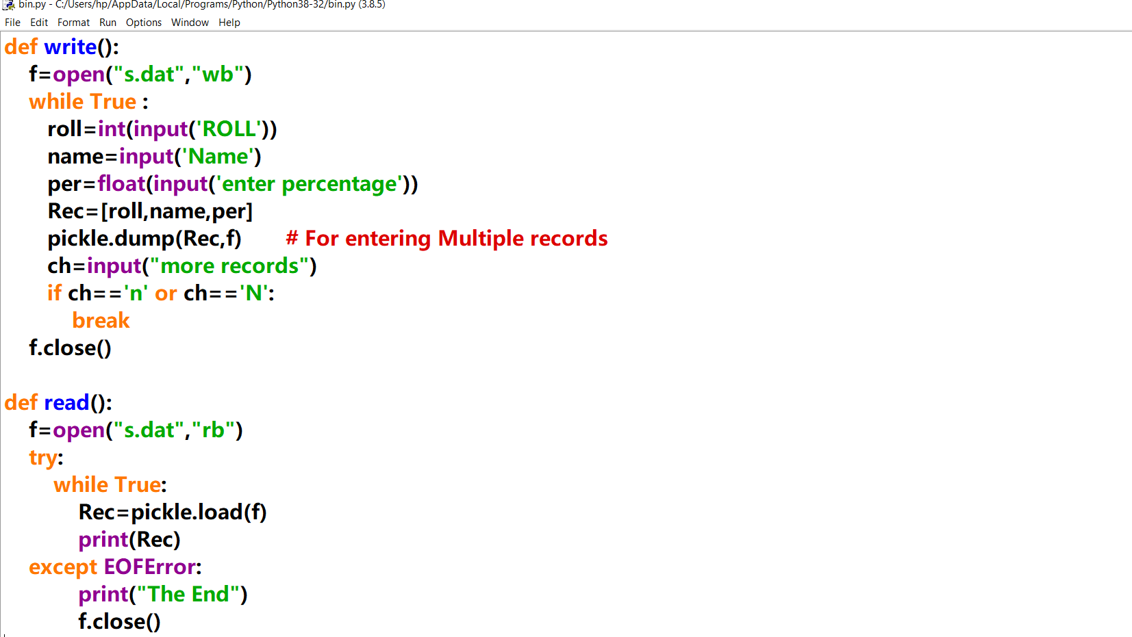
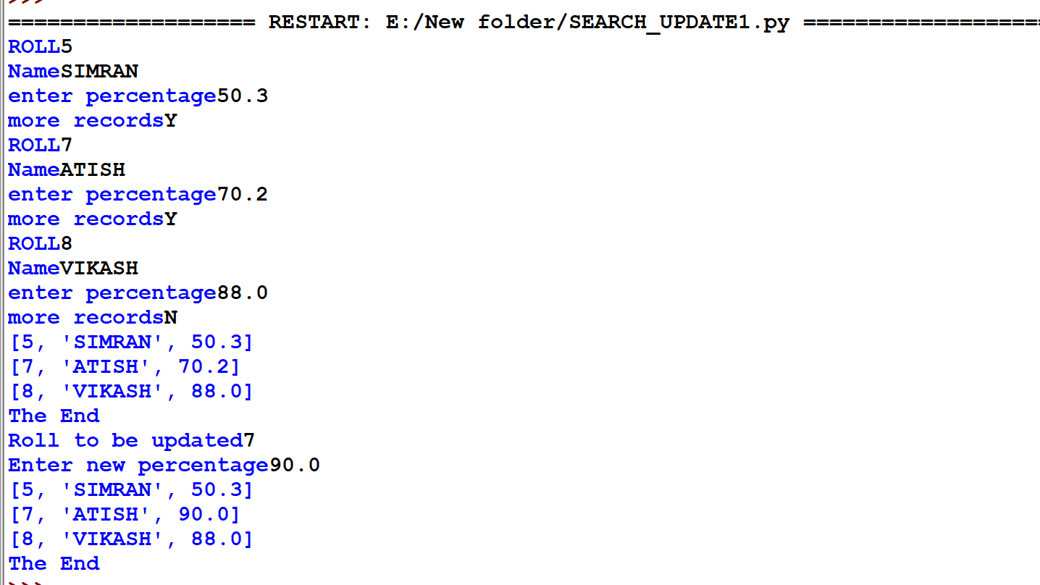

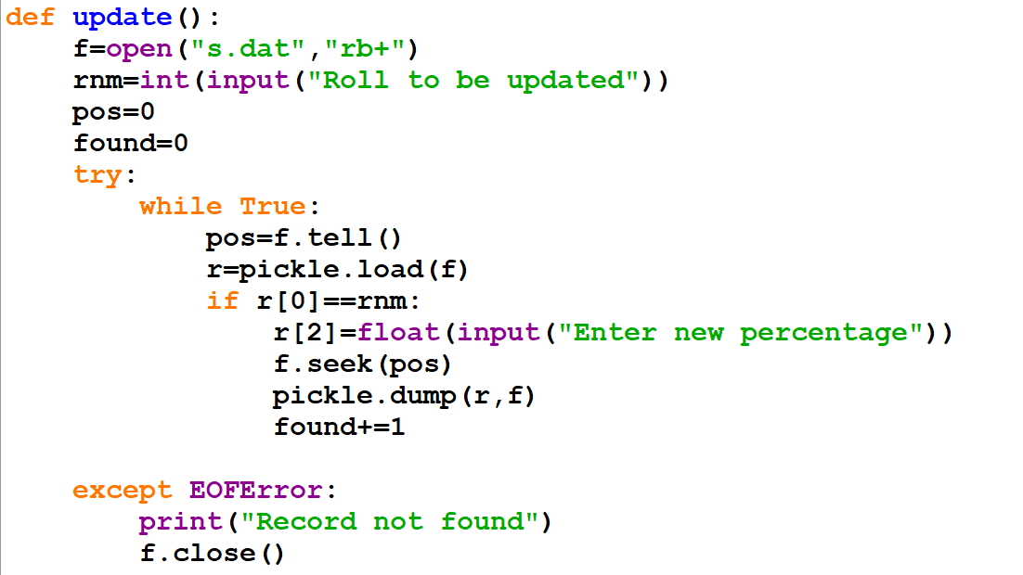
SOURCE CODE
OUTPUT
HANDS ON

Slide 24
Binary File(pickle) - Update
name = input('Name to update :')
file = open("student.dat", "rb+")
list = pickle.load(file)
found = 0
lst = []
for x in list:
if name in x['name']:
found = 1
x['name'] = input('Enter new name ')
lst.append(x)
if(found == 1):
file.seek(0)
pickle.dump(lst, file)
print("Record Updated")
else:
print('Name does not exist')
file.close()
Mode “rb+” is used to read and write at the same time.
Name to update :Satya
Enter new name Shree Ram
Record Updated
Bring writing head at the beginning of file

Slide 25
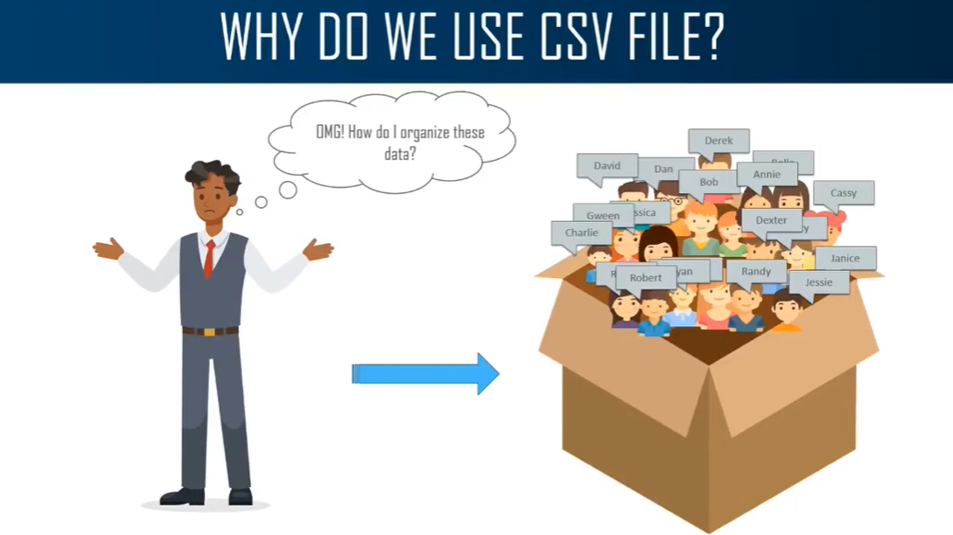
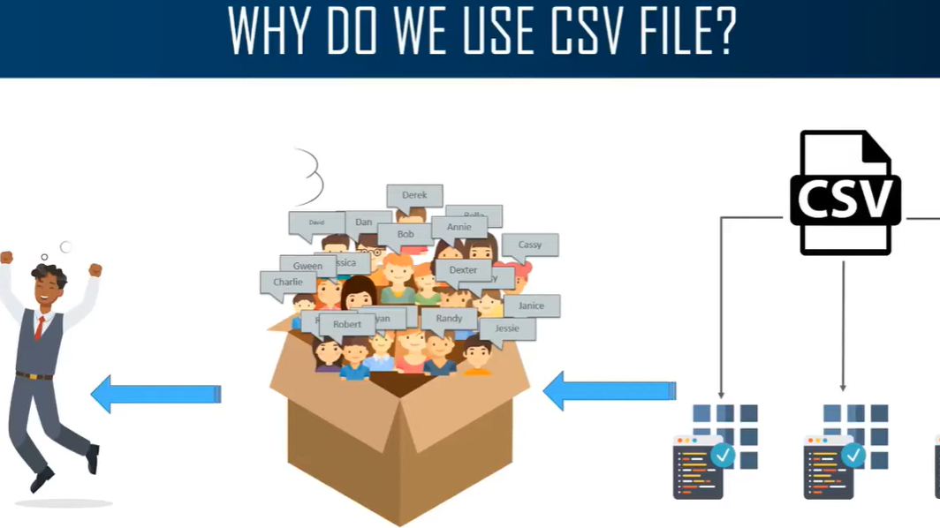

INTRODUCTION TO CSV FILE IN PYTHON
CSV Stands for Comma Separated Values
Its used for Storing tabular data in spreadsheet or database.
Each record consists of fields Separated by commas(delimiter)
Each Line of the file is called a record

Slide 26
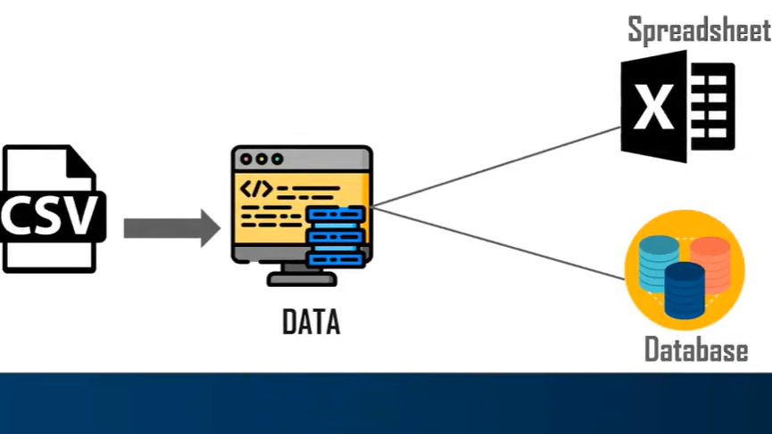
File handling – CSV File
Sample CSV file generated using Excel
Rollno,name,class,stream,agg,percenrage,result
1,Ram,12B,SCIENCE,484,96.8,PASS
2,Anuj,11A,COMM,452,90.4,PASS
3,Nipun,11A,COMM,347,69.4,PASS
First row contains the header
Single record
Each line considered row/record which has many fields .Fields are the values separated by a delimeter like
a ‘;’, ‘, ’ ,‘*’ ,
’/’ etc .
Data Exchange File

Slide 27
WRITING IN CSV FILES
CS_writer = csv. writer(File Object)
CSV module is used to read/write in a csv file
csv.writer()function converts the file object into writer
object for writing the records
csv.writerow() inserts the record in to the csv file
Records can be written as a nested list or Dictionary
SYNTAX

Slide 28
READING A CSV FILE
CSV module is used to read/write in a csv file
csv.reader()function is used to read the records
from the CSV file
The records read are in the form of list of list
Records can also be read into a Dictionary using
csv.DictReader ()function
CS_reader = csv. reader(File Object)
SYNTAX

Slide 29
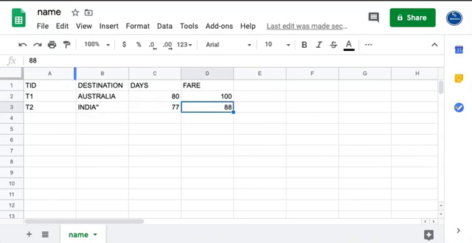
File handling – CSV( Reader) - READ
import csv
f = open(r"C:\Users\geetanjali\Desktop\student.csv", "r")
data = csv.reader(f)
for record in data:
print(record)
f.close()
It return the CSV object in “data”
['Rollno', 'name', 'class', 'stream', 'agg', 'percenrage', 'result']
['1', 'ramji', '12B', 'SCIENCE', '484', '96.8', 'PASS']
['2', 'anuj', '11A', 'COMM', '452', '90.4', 'PASS']
['3', 'ujjwal', '12C', 'HUMAN', '385', '77', 'PASS']
……..
['10', 'harsh', '11C', 'HUMAN', '455', '91', 'PASS']

Slide 30
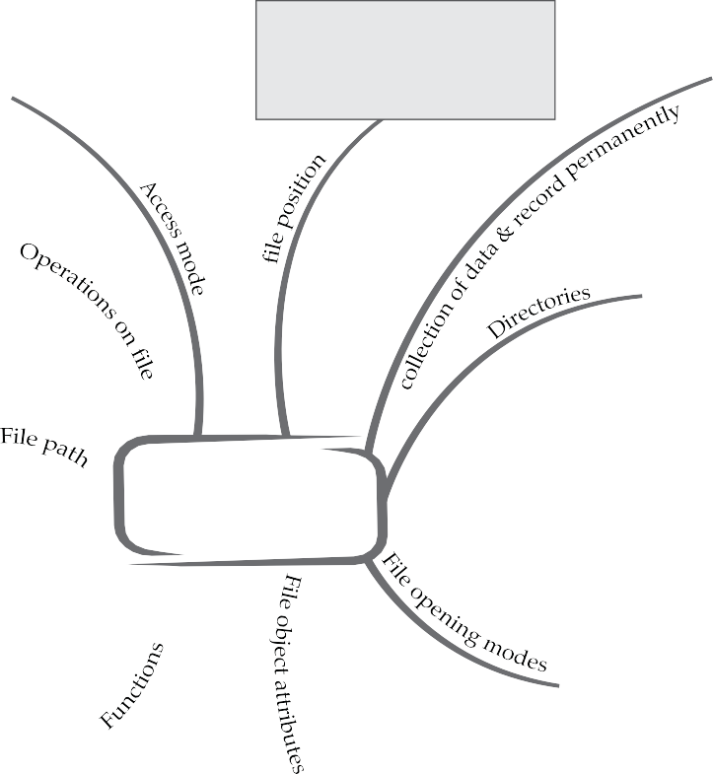

T O P I C - F I LE HANDLING
To know about more useful books for class-12 click here
1. Text file : They store information in ASC II or Unicode characters. Each line of text is terminated with a especial character EOL.
2. Binary file : They contain information in the same format in which the information is held in memory.
3. CSV File –Contains text which can be
opened by any text editor contains plain
text with no format
Oswaal CBSE Chapterwise Mind Maps, computer science, Class – XII
read : It opens a file in read mode.
write : It opens a file in write mode.
append : It opens a file to add some data
tell ( ) It tells us the current position of the file pointer.
seek ( ) It moves the file pointer to the specified position.
1. open ( ) : It creates a file object, which would be utilized to ca
call
Syntax file Object =open ( file name [, access mode]
[ buffering ]
write ( ) : This method writes any string to an open file Syntax file
Object. write (string)
3. read ( ) : This method records a string to an open file. Syntax file
Object. read ([count])
4. close ( ) : It closes the file Syntax file Object.close ( )
TEXT FILE
1. read ( ) : It reads atmost n bytes and returns the read bytes
2. readline ( ) : It reads a line of input and return it in the form of a string.
3. readlines ( ) : It reads all lines and returns them in a list.
4. write ( ) : it writes string to file referenced by <file handle>.
5. writelines ( ) : It writes all string in list L as lines to file referenced File
handle
6. flush ( ) : It forces the writing of data on disc that is still pending in
output buffer.
7. split ( ) : It splits a line in column. It returns columns as item in list.
8. rename ( ) : It used to rename the file existing on the disk.
9. remove ( ) : It is used to delete a file existing on the disk.
10.os.path.split ( ) : It is used to split of the last path component.
11. os.path.exist ( ) : It checks if a path actually exist.
File Handling
1 r mode : It opens a file for reading only. This is
default mode.
2. rb mode : It opens a file for reading only in binary format.
3.r+ mode : It opens a file for both reading and writing.
4. rb+ mode : It opens a file for both reading and writing in
binary format.
5. w mode : It opens a file for writing only. Overwrites
the file if the file exists.
6. wb mode : It opens a file for writing only in binary format.
7.w+ mode : It opens a file for both writing and reading.
8.wb+ mode : It opens a file for both writing and reading in
binary format.
9. a mode : It opens a file for appending. The file pointer
is at the end of the file, if the file exists.
10. ab mode : It opens a file for appending in binary format.
11 a+ mode : It opens a file for both appending and reading.
12. ab+ mode : It opens a file for both appending and
reading in binary format.
1 file.closed : It returns true if file is closed,
false otherwise.
2. file.mode : It returns access mode with
which file was opened.
3. file.name : It returns name of the file
4. file.encoding - :It shows the default encoding
system of the file
[
3

Slide 31





LETS WORK OUT SAMPLE BOARD QUESTIONS !

Slide 32


WAP to read the text file and prints only the numbers or digits.
F=open(“an.txt”,”r”)
for line in F :
words=line.split()
for i in words :
for letter in i:
if(letter.isdigit())
print(letter)

Slide 33

CBSE SAMPLE QUESTIONS
FOR YOUR REFERENCE
http://cbseacademic.nic.in/web_material/SQP/ClassXII_2019_20/ComputerScience_SQP.pdf
Write a program to count the words “to” and “the” present in a text file
Read the text file and prints only the numbers or digits from file.
program to find out the total number of words in any given test file
Count the number of occurrences of a character in a text file .
program to find out total number of lines that start with alphabet ‘S’
WAP to create a file to hold some data ,separated as lines.

